Slide 1


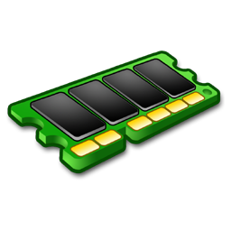
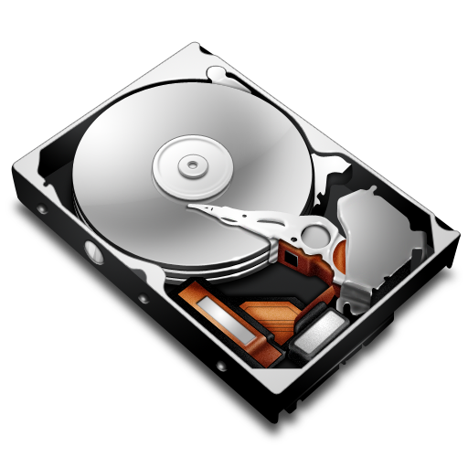
Your computer
The Cloud
Screen
Harddrive
Memory

Slide 2

The Cloud
Memory
2) Import
Harddrive
The Python Directory
1) Install

